Slide 1

7th Grade Math
Unit 7, Lesson 8 Simple Interest Volume 1, pg. 331

Slide 2


Benchmark
MA.7.AR.3.1
Apply previous understanding of percentages and ratios to solve multi-step real-world percent problems.
volume 1, pg. 331

Slide 3
Integrated Mathematical Thinking and Reasoning Standards
MA.K12.MTR.1.1 Actively participate in effortful learning both individually and collectively.
MA.K12.MTR.2.1 Demonstrate understanding by representing problems in multiple ways.
MA.K12.MTR.7.1 Apply mathematics to real-world contexts.
volume 1, pg. 331

Slide 4

Learning Targets
I can solve problems that involve simple interest.
I can compare simple interest and compound interest.
volume 1, pg. 331

Slide 5

Warm-Up
volume 1, pg. 332

Slide 6
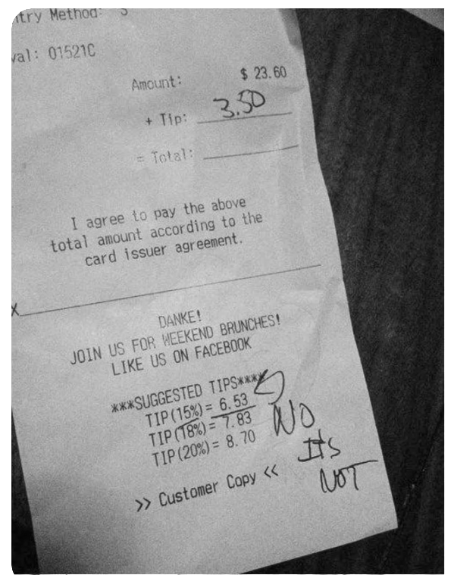
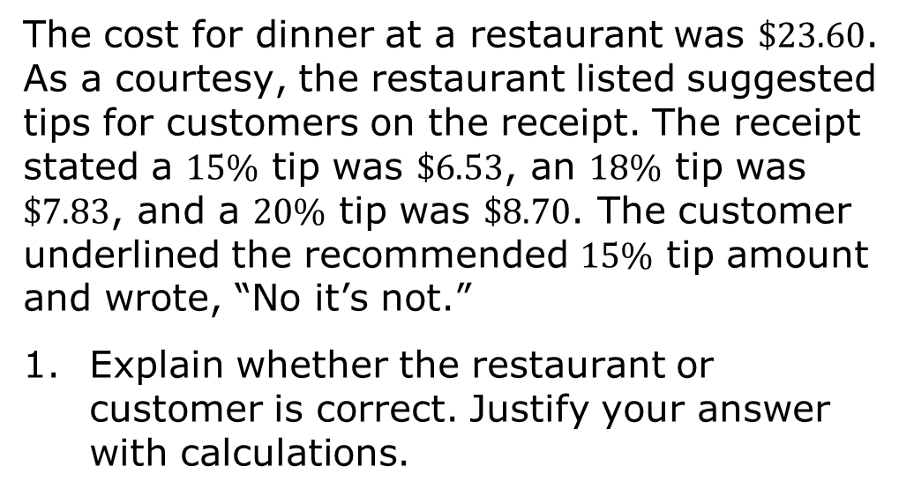
7.8.1 Warm-Up: Math Fail
The cost for dinner at a restaurant was $23.60. As a courtesy, the restaurant listed suggested tips for customers on the receipt. The receipt stated a $15\%$ tip was $6.53, an $18\%$ tip was $7.83, and a $20\%$ tip was $8.70. The customer underlined the recommended $15\%$ tip amount and wrote, “No it’s not.”
Explain whether the restaurant or customer is correct. Justify your answer with calculations.
volume 1, pg. 332

Slide 7

Guided Instruction
volume 1, pg. 332

Slide 8


7.8.2 Guided Instruction: Simple Interest
Kristina received $\$100$ in a birthday card and wants to put the money into her savings account, where she will earn an additional $2\%$ each year it remains in her account. This is known as simple interest.
How much is $2\%$ of $\$100$?
Simple interest is a method of computing interest. Interest is computed from the (original) principal alone, no matter how much money has accrued so far.
volume 1, pg. 332

Slide 9
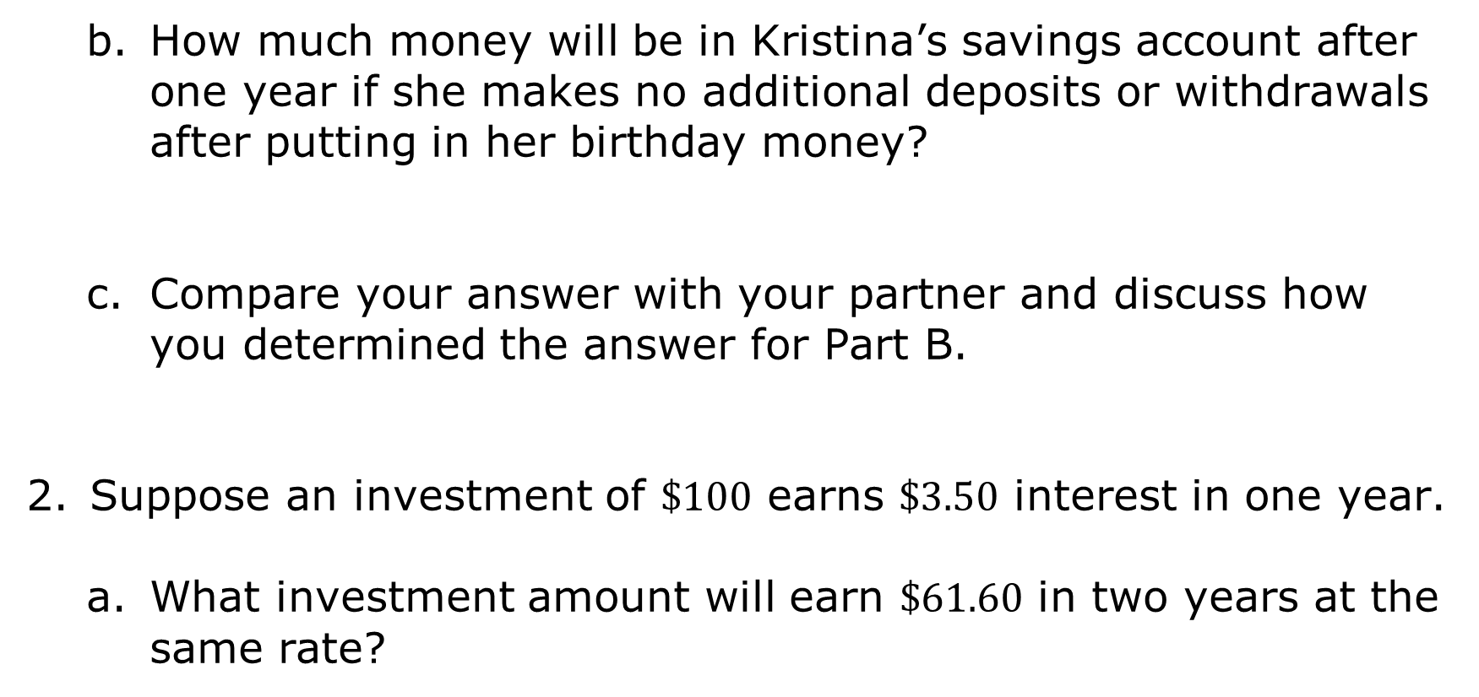
How much money will be in Kristina’s savings account after one year if she makes no additional deposits or withdrawals after putting in her birthday money?
Compare your answer with your partner and discuss how you determined the answer for Part B.
Suppose an investment of $\$100$ earns $\$3.50$ interest in one year.
What investment amount will earn $\$61.60$ in two years at the same rate?
volume 1, pg. 332

Slide 10
Ask two other partner pairs to describe how they found the initial investment. Record their initial investment and write your summary of their process. You are the only person who should write in the first two columns of the table. Have the person initial next to your summary stating that your summary was correct.
Review the initial investments and reasons provided by other partner pairs. If necessary, fix any mistakes you and your partner made.
Initial Investment | My Summary of Their Reason | Initials
volume 1, pg. 333

Slide 11


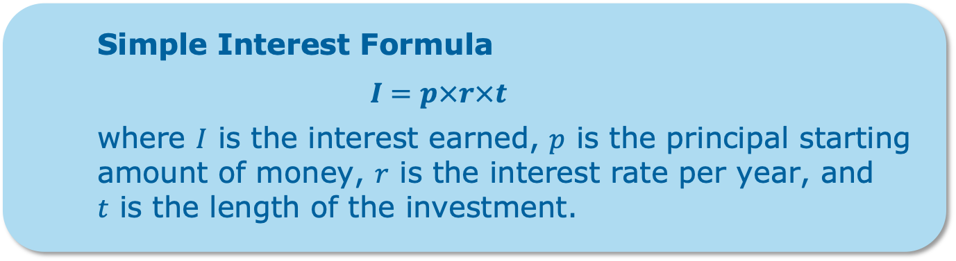
Tonio took out a six-year car loan for $\$15,600$, with a $3\%$ simple interest rate over the life of the loan.
How much interest, in dollars, will Tonio pay annually?
How much will Tonio pay in interest over the course of six years?
Simple Interest Formula
$$I=p×r×t$$
where $I$ is the interest earned, $p$ is the principal starting amount of money, $r$ is the interest rate per year, and $t$ is the length of the investment.
volume 1, pg. 333

Slide 12
What is the total amount Tonio will pay back at the end of his six-year loan?
Explain why the total amount Tonio will have paid back by the end of his loan is more than the loan amount he borrowed.
volume 1, pg. 334

Slide 13

Try It
volume 1, pg. 334

Slide 14

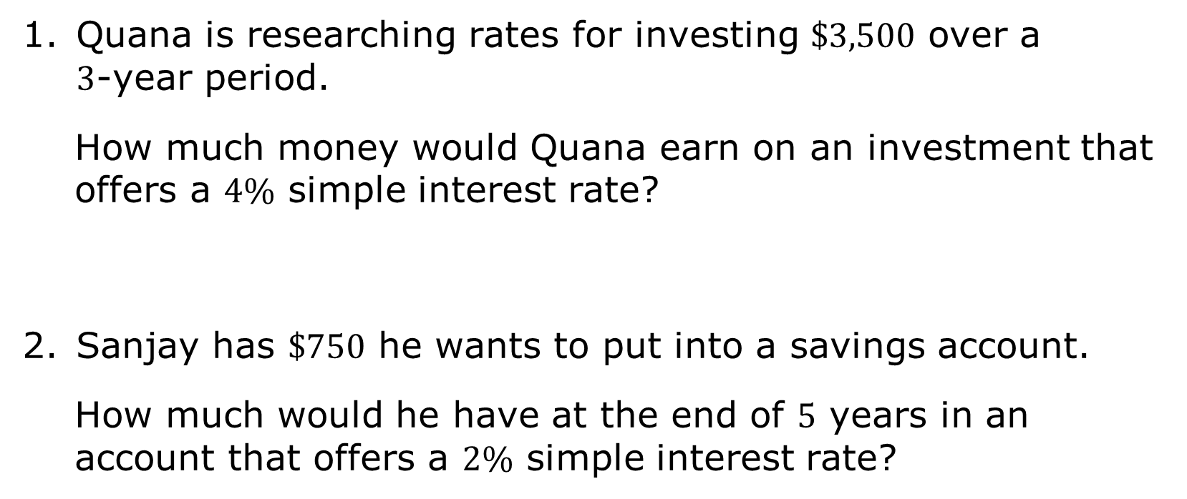
7.8.3 Try It: Simple Interest
Quana is researching rates for investing $\$3,500$ over a 3-year period.
How much money would Quana earn on an investment that offers a $4\%$ simple interest rate?
Sanjay has $\$750$ he wants to put into a savings account.
How much would he have at the end of 5 years in an account that offers a $2\%$ simple interest rate?
volume 1, pg. 334

Slide 15

Collaboration
volume 1, pg. 335

Slide 16

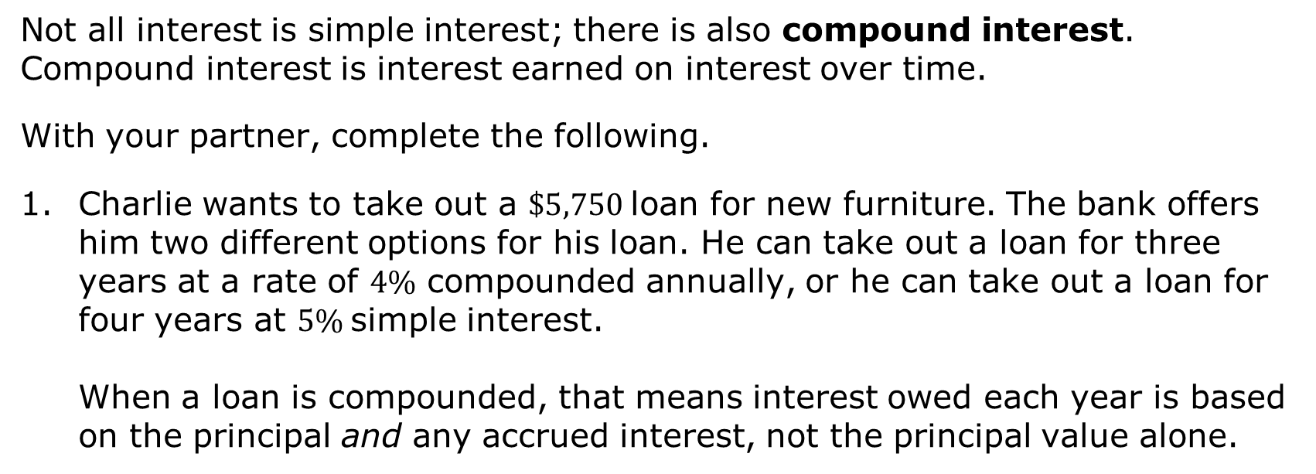
7.8.4 Collaboration: Comparing Interest
Not all interest is simple interest; there is also compound interest. Compound interest is interest earned on interest over time.
With your partner, complete the following.
Charlie wants to take out a $\$5,750$loan for new furniture. The bank offers him two different options for his loan. He can take out a loan for three years at a rate of $4\%$ compounded annually, or he can take out a loan for four years at $5\%$simple interest.
When a loan is compounded, that means interest owed each year is based on the principal and any accrued interest, not the principal value alone.
volume 1, pg. 335

Slide 17
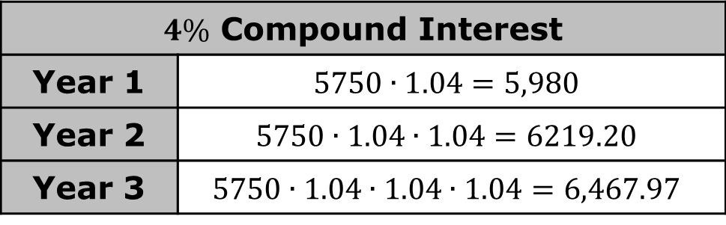
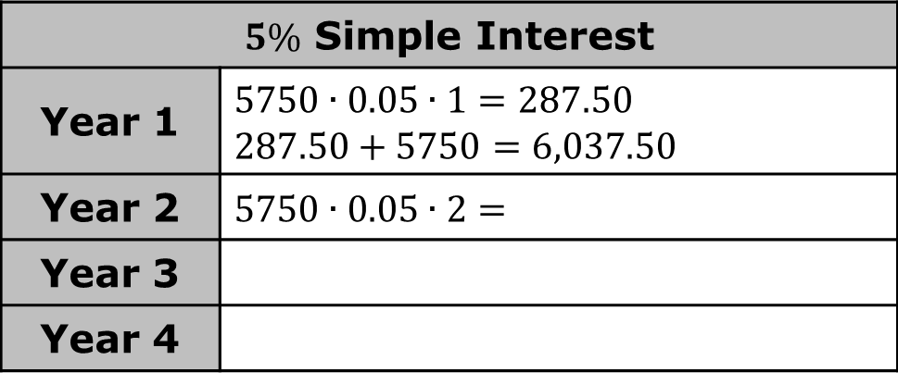
The compound interest table has been filled out. Complete the simple interest table to help Charlie choose the loan he will pay the least.
Explain which loan Charlie should choose.
$4\%$ Compound Interest
Year 1 | $$5750∙1.04=5,980$$
Year 2 | $$5750∙1.04∙1.04=6219.20$$
Year 3 | $$5750∙1.04∙1.04∙1.04=6,467.97$$
$5\%$ Simple Interest
Year 1 | $$5750∙0.05∙1=287.50$$ $$287.50+5750=6,037.50$$
Year 2 | $$5750∙0.05∙2=$$
Year 3
Year 4
volume 1, pg. 335

Slide 18
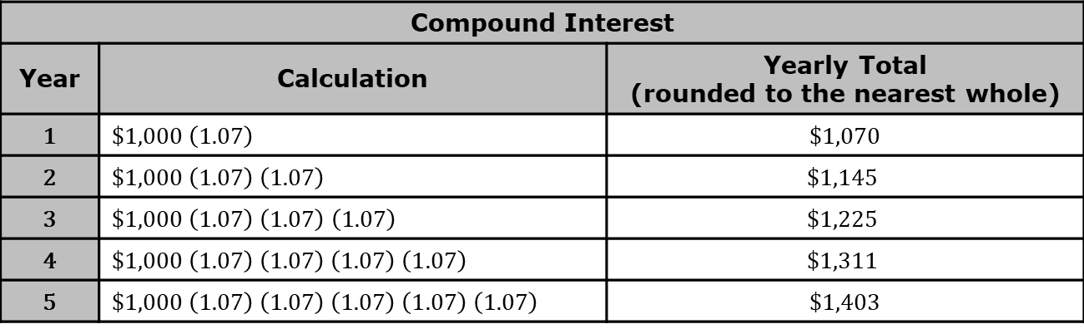
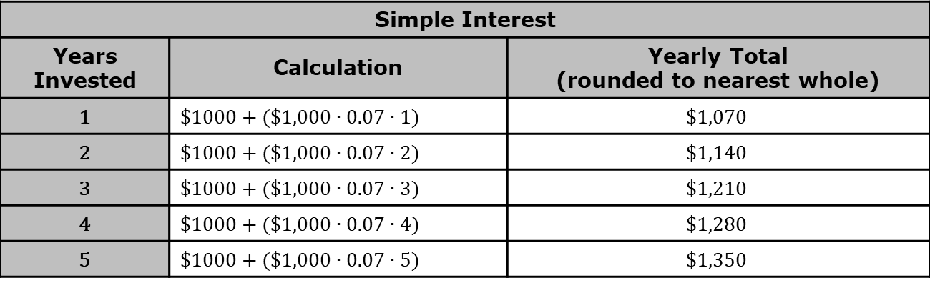
The two tables summarize different options Valentina has to invest $\$1,000$. Use the tables to answer the questions.
Simple Interest
Years Invested | Calculation | Yearly Total (rounded to nearest whole)
1 | $$\$1000+(\$1,000∙0.07∙1)$$ | $$\$1,070$$
2 | $$\$1000+(\$1,000∙0.07∙2)$$ | $$\$1,140$$
3 | $\$1000+($$1,000 $∙0.07∙3)$ | $$\$1,210$$
4 | $$\$1000+(\$1,000∙0.07∙4)$$ | $$\$1,280$$
5 | $$\$1000+(\$1,000∙0.07∙5)$$ | $$\$1,350$$
Compound Interest
Year | Calculation | Yearly Total (rounded to the nearest whole)
1 | $$\$1,000 \left(1.07\right)$$ | $1,070
2 | $$\$1,000 \left(1.07\right) \left(1.07\right)$$ | $$\$1,145$$
3 | $\$1,000 \left(1.07\right) \left(1.07\right)$ $\left(1.07\right)$ | $$\$1,225$$
4 | $$\$1,000 \left(1.07\right) \left(1.07\right) \left(1.07\right) \left(1.07\right)$$ | $$\$1,311$$
5 | $$\$1,000 \left(1.07\right) \left(1.07\right) \left(1.07\right) \left(1.07\right) \left(1.07\right)$$ | $1,403
volume 1, pg. 335

Slide 19
How are the two tables similar?
How are they different?
How are these similarities and differences represented in the calculation column for each scenario?
Find another partner pair and discuss the following.
How does the growth in an account that calculates compound interest compare to the growth in an account that calculates simple interest?
volume 1, pg. 336

Slide 20

Wrap-Up
volume 1, pg. 337

Slide 21

7.8.5 Wrap-Up: Cool Down
Your friend is absent and will need to make up the lesson from today. Write a quick note to help them understand what simple interest is, how to calculate it, and how to use it to solve problems.
volume 1, pg. 337

